Slide 1
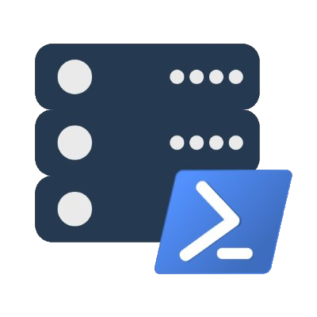
Modern Database Administration using PowerShell and dbatools
Chrissy LeMaire & Rob Sewell

Slide 2
Agenda
Overview
Requirements
Hella demos
Questions
Notes:
No code

Slide 3
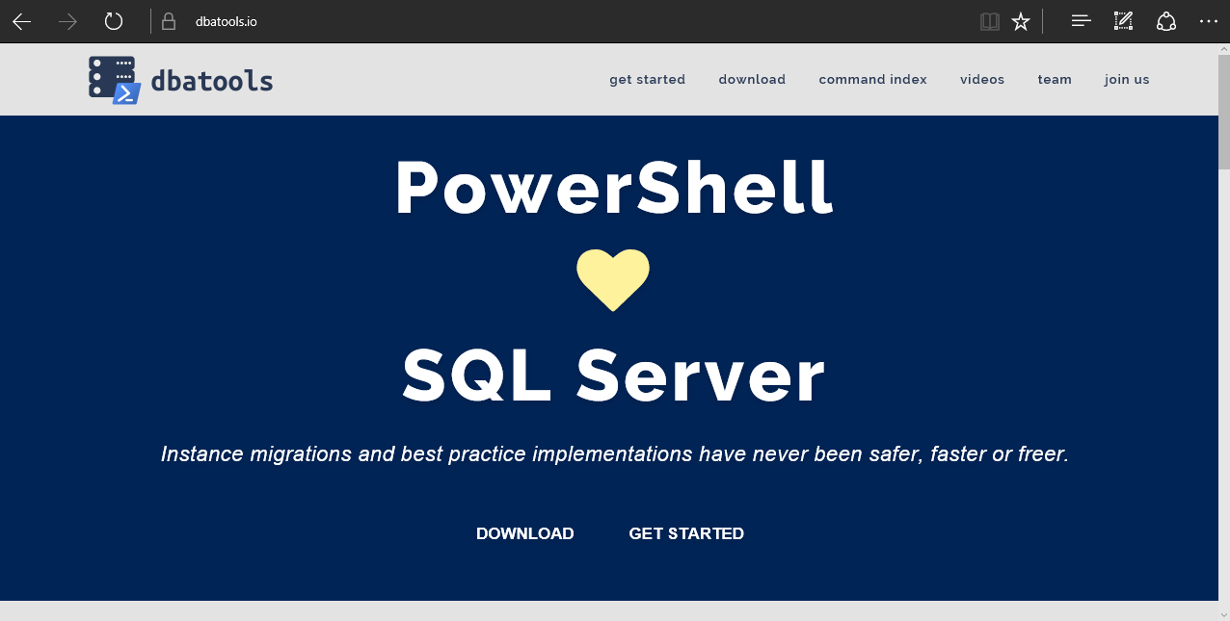
Notes:
Community project, initially started out as Start-SqlMigration but has grown into a DBA’s best friend. dbatools currently sports over 180 commands. Open source, 50+ contributors
How many of you have heard of dbatools? How many of you have used it?

Slide 4
System Requirements
Minimum
Client
PowerShell v3
SQL Server Management Studio 2008 R2
Server
SQL Server 2000
No PowerShell for pure SQL commands
PowerShell v2 for Windows commands
Recommended
Client
PowerShell v5
SQL Server Management Studio 2012+
Server
SQL Server 2005+

Slide 5
Install is easy
PowerShell Gallery
Install-Module dbatools
Install-Module dbatools –Scope CurrentUser
GitHub – dbatools.io/git
Invoke-Expression (Invoke-WebRequest https://dbatools.io/in)
Clone repo found at dbatools.io/git, Import-Module dbatools
Notes:
Solve people’s problems
But make sure you LOVE what you’re working on

Slide 6
Visit the site
Notes:
Solve people’s problems
But make sure you LOVE what you’re working on

Slide 7
Demos!
Demos
Notes:
Solve people’s problems
But make sure you LOVE what you’re working on

Slide 8
Summary
dbatools simplifies the life of a data pro
dbatools wants you!
dbatools.io/firstpull
dbatools.io/firstpullvideo

Slide 9
Next Steps...
Now: 15 min break
Grab a coffee
Stay here to enjoy next presentation
Change track and switch to another room
Ask me questions or meet me in a breakout session room afterwards

Slide 10
Questions?

Slide 11
About_Author
PowerShell MVP
Creator of dbatools.io
PASS PowerShell VG, Belgian PowerShell UG
DBA with General Dynamics IT at NATO Spec Ops

